Slide 1
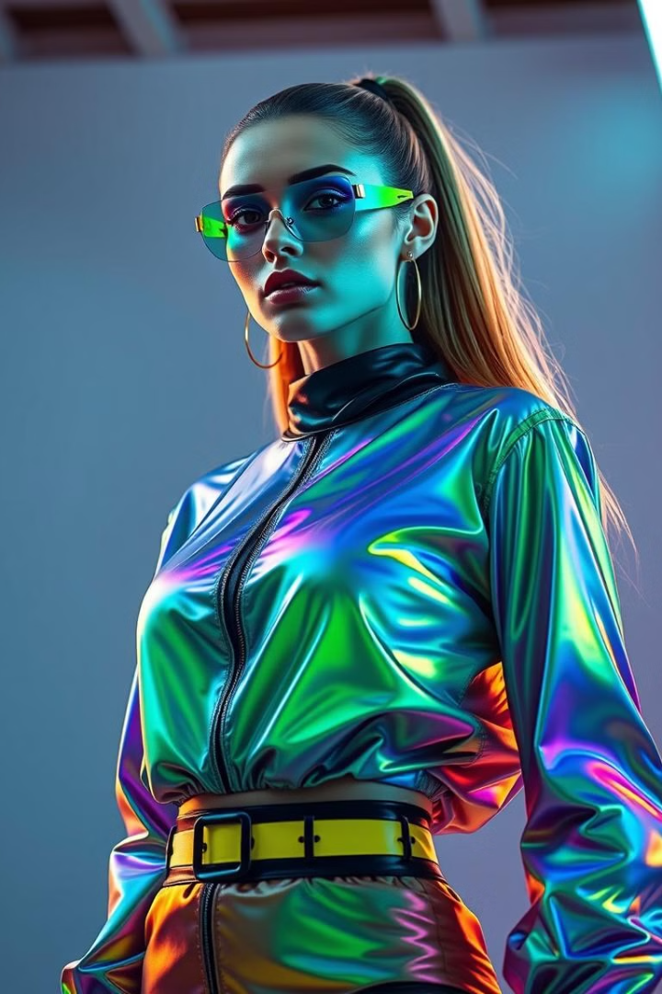

Artificial Intelligence in Fashion
AI is transforming every industry, and fashion is no exception. Explore the key ways AI is driving innovation and efficiency in fashion.
by ShaTech jsjk

Slide 2
AI and Fashion Operations: Streamlining Sustainability
Optimized Production
Sustainable Material Sourcing
AI helps predict demand, manage inventory, and optimize production processes. This can reduce waste, minimize overproduction, and promote sustainability.
AI can analyze vast data sets on material properties and environmental impact to identify sustainable options, reducing the fashion industry's environmental footprint.

Slide 3
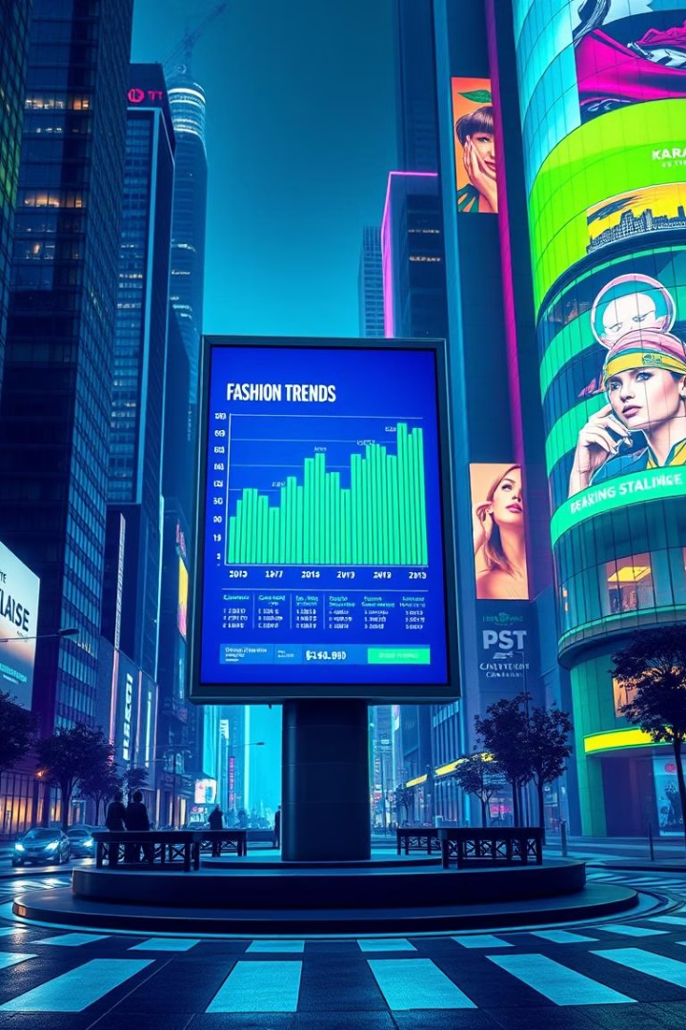
AI-Powered Trend Analysis: Predicting the Future of Fashion
1
Social Media Analysis
2
Sales Data Insights
AI can analyze social media trends and customer preferences to identify emerging styles and predict future fashion trends.
AI algorithms can identify patterns in sales data to predict customer demand and ensure that the right products are available at the right time.
3
Competitive Intelligence
AI can track competitors' product launches, marketing campaigns, and price changes, providing valuable insights for strategic decision-making.

Slide 4

Generative Design: Unlocking Innovative Product Development
Automated Design
Personalized Fashion
AI algorithms can generate new design concepts based on predefined parameters and aesthetic principles, enabling designers to explore unconventional ideas.
AI can tailor designs to individual customer preferences, creating personalized garments that meet specific needs and preferences.
Sustainable Innovation
Generative design can explore new materials and manufacturing processes, leading to more sustainable and innovative fashion products.

Slide 5
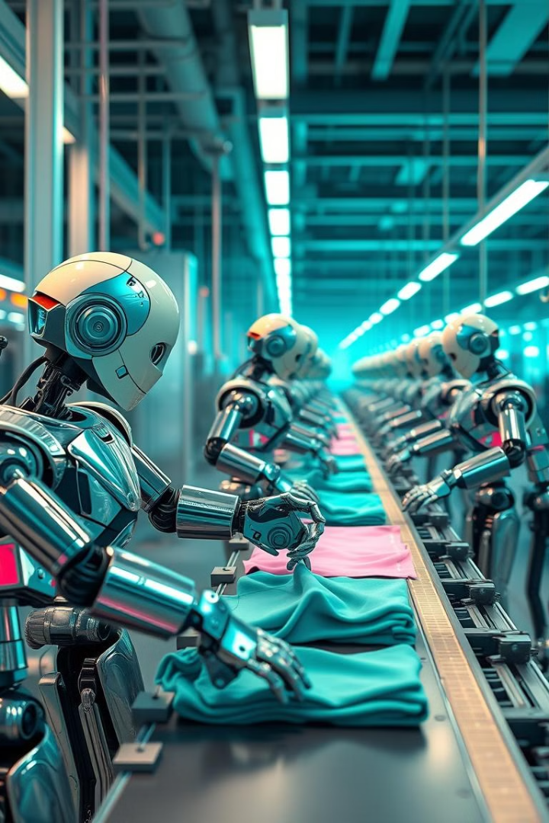



Demand Forecasting with AI: Optimizing the Supply Chain
Data-Driven Predictions
Optimized Inventory
AI analyzes historical sales data, market trends, and external factors to generate accurate forecasts for future demand.
AI-powered demand forecasting helps ensure that the right amount of inventory is available at the right time, minimizing waste and improving logistics.
Faster Lead Times
AI can optimize the supply chain by identifying bottlenecks and improving communication, leading to faster production times and reduced delivery delays.

Slide 6

AI for Sustainable Fashion Practices
1
Reduce Waste
AI can analyze data to identify patterns in clothing waste and recommend strategies for reducing waste throughout the fashion supply chain.
2
Promote Circularity
AI can help develop platforms for clothing rental, resale, and repair, promoting a circular economy model for fashion.
3
Sustainable Materials
AI can analyze data on material properties and environmental impact to recommend sustainable materials and encourage their use in the fashion industry.

Slide 7
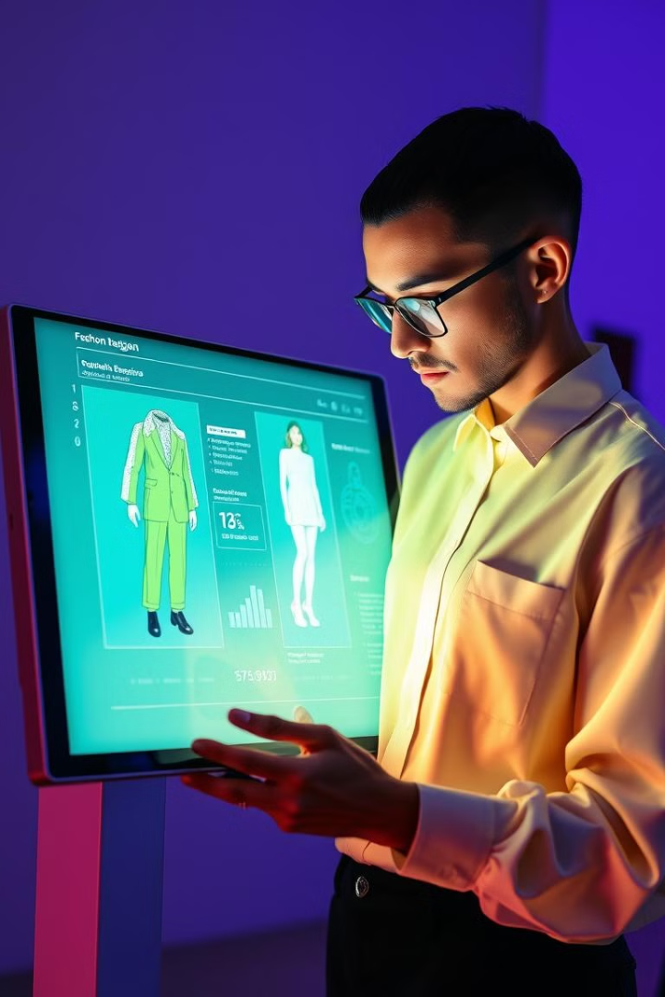



Integrating AI into Product Lifecycle Management
Design & Development
AI can assist designers with design ideation, material selection, and pattern creation, streamlining the development process.
Production & Manufacturing
AI can optimize production processes, manage inventory, and ensure quality control throughout the manufacturing process.
Distribution & Sales
AI can predict demand, manage logistics, and personalize marketing campaigns, leading to more efficient and targeted sales strategies.

Slide 8



Enhancing Quality Control with AI in Fashion
Defect Detection
AI algorithms can analyze images and videos to identify defects in clothing, ensuring that only high-quality products reach customers.
1
Material Analysis
2
AI can analyze the composition and properties of materials to ensure compliance with quality standards and regulations.
Improved Efficiency
3
AI-powered quality control systems can significantly reduce the time and effort required for manual inspection, increasing efficiency and reducing costs.

Slide 9
Inventory Management and Logistics: AI-Driven Efficiency
Demand Forecasting
1
AI algorithms can predict future demand based on historical data, seasonal patterns, and market trends, allowing for more accurate inventory planning.
Optimized Routing
2
AI can optimize delivery routes, reducing transportation costs and minimizing delivery time, resulting in greater efficiency and customer satisfaction.
Smart Warehouse Management
3
AI-powered systems can manage warehouse operations, optimize storage space, and automate tasks, reducing labor costs and improving overall efficiency.

Slide 10
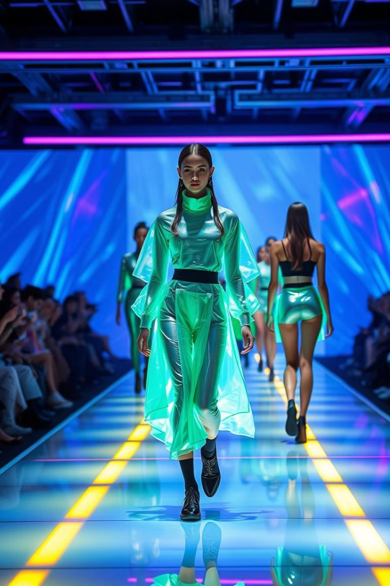
The Future of Fashion: Embracing AI-Powered Transformation
1
2
Personalized Fashion
Sustainable Solutions
AI will enable the creation of truly personalized clothing, tailored to individual preferences and body shapes.
AI will drive the development of sustainable materials, processes, and business models in the fashion industry.
3
Immersive Experiences
AI will revolutionize the way we shop for fashion, with virtual try-ons and personalized recommendations becoming the norm.

